Slide 1
Sparklines Hands On
Data Visualization
John F. Tripp

Slide 2
Sparklines
Present the general shape of variation over time.
Have no axes or gridlines
Are extremely information dense.
Replace large graphical components on dashboards
Allow for more insight at a glance.

Slide 3
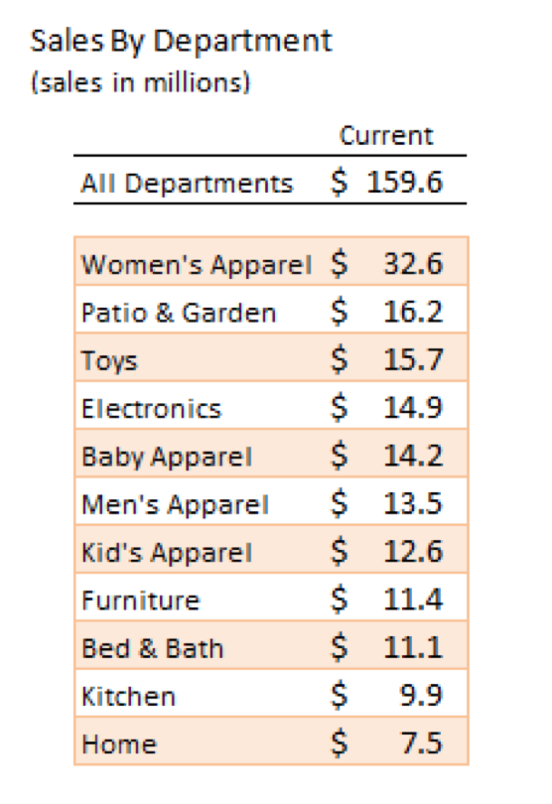

Slide 4
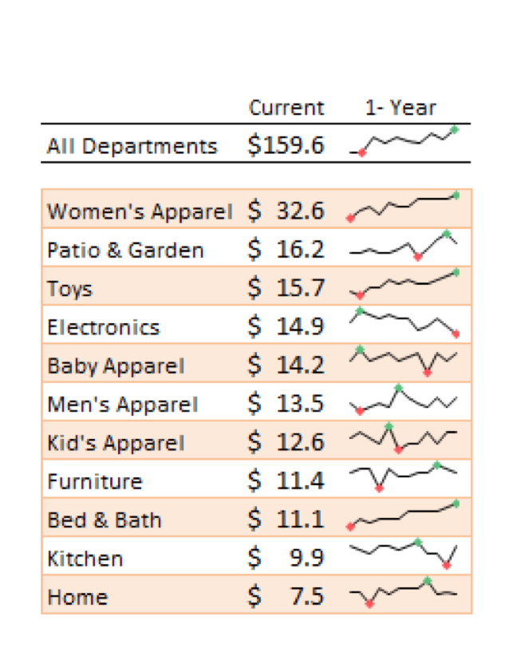

Slide 5
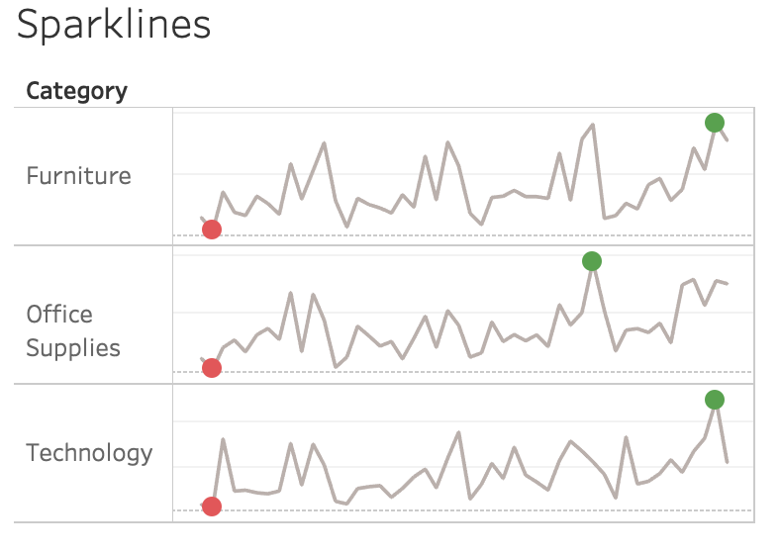
Simple Sparklines
We’re going to start by making this, step by step:

Slide 6
Hands On - Sparklines
Open the Sparklines – Start.twbx file.
Create a chart that has:
  Continuous MONTH(Order Date) in the columns
  Category and Sum(Sales) in the rows.
Your graph should look like this…

Slide 7
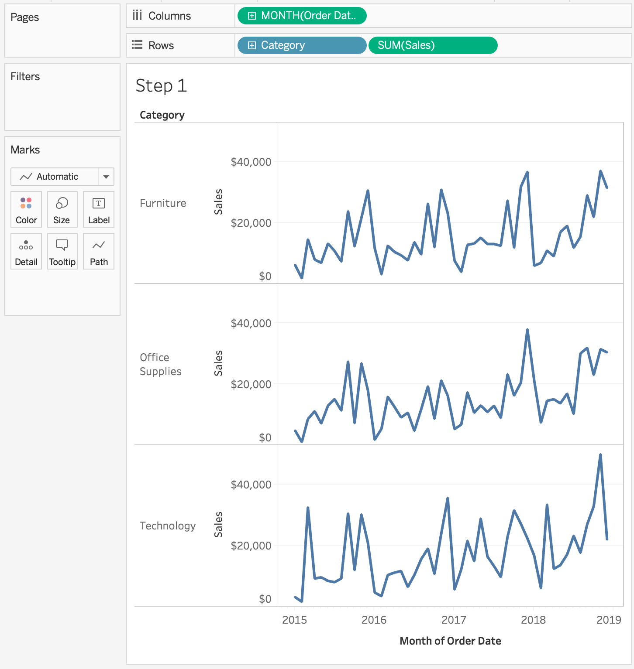
Hands On - Sparklines
Open the Sparklines and Bullet Graphs – Start.twbx file.
Create a chart that has:
  Continuous MONTH(Order Date) in the columns
  Category and Sum(Sales) in the rows.
Your graph should look like this…

Slide 8
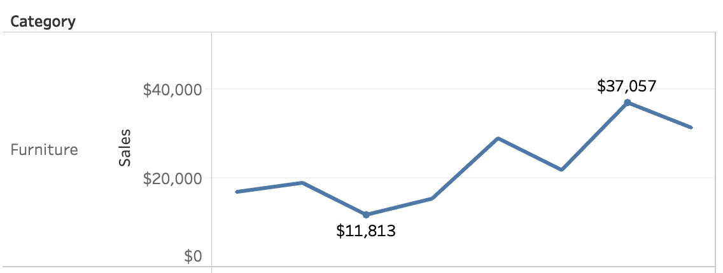
Hands On - Sparklines
Next, we will add the high and low points to the graph.
This is NOT an out of the box option in Tableau.
  You COULD add labels to the Max/Min using the Marks Card, but that’s not what we want.

Slide 9
Hands On - Sparklines
Your workbook has a field called “HighLow”. Right click and open it for editing to look at the formula:

Slide 10
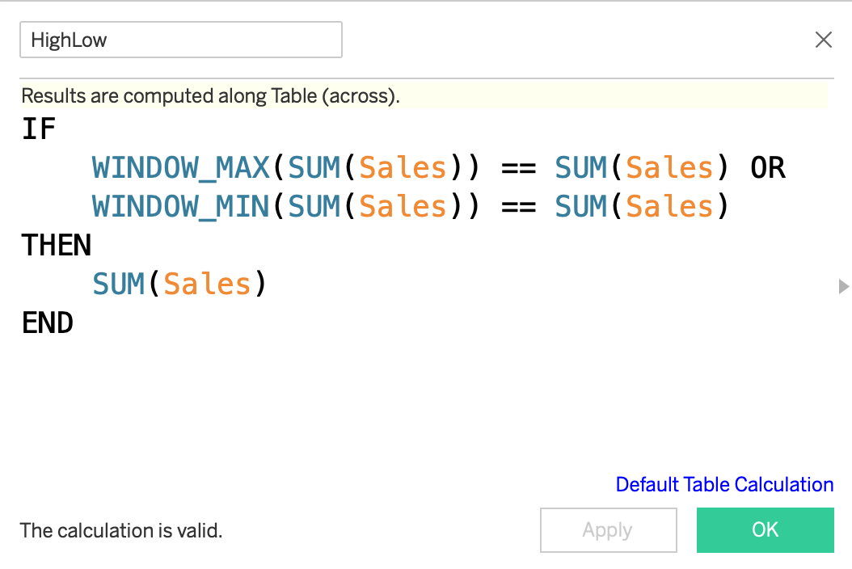

Slide 11
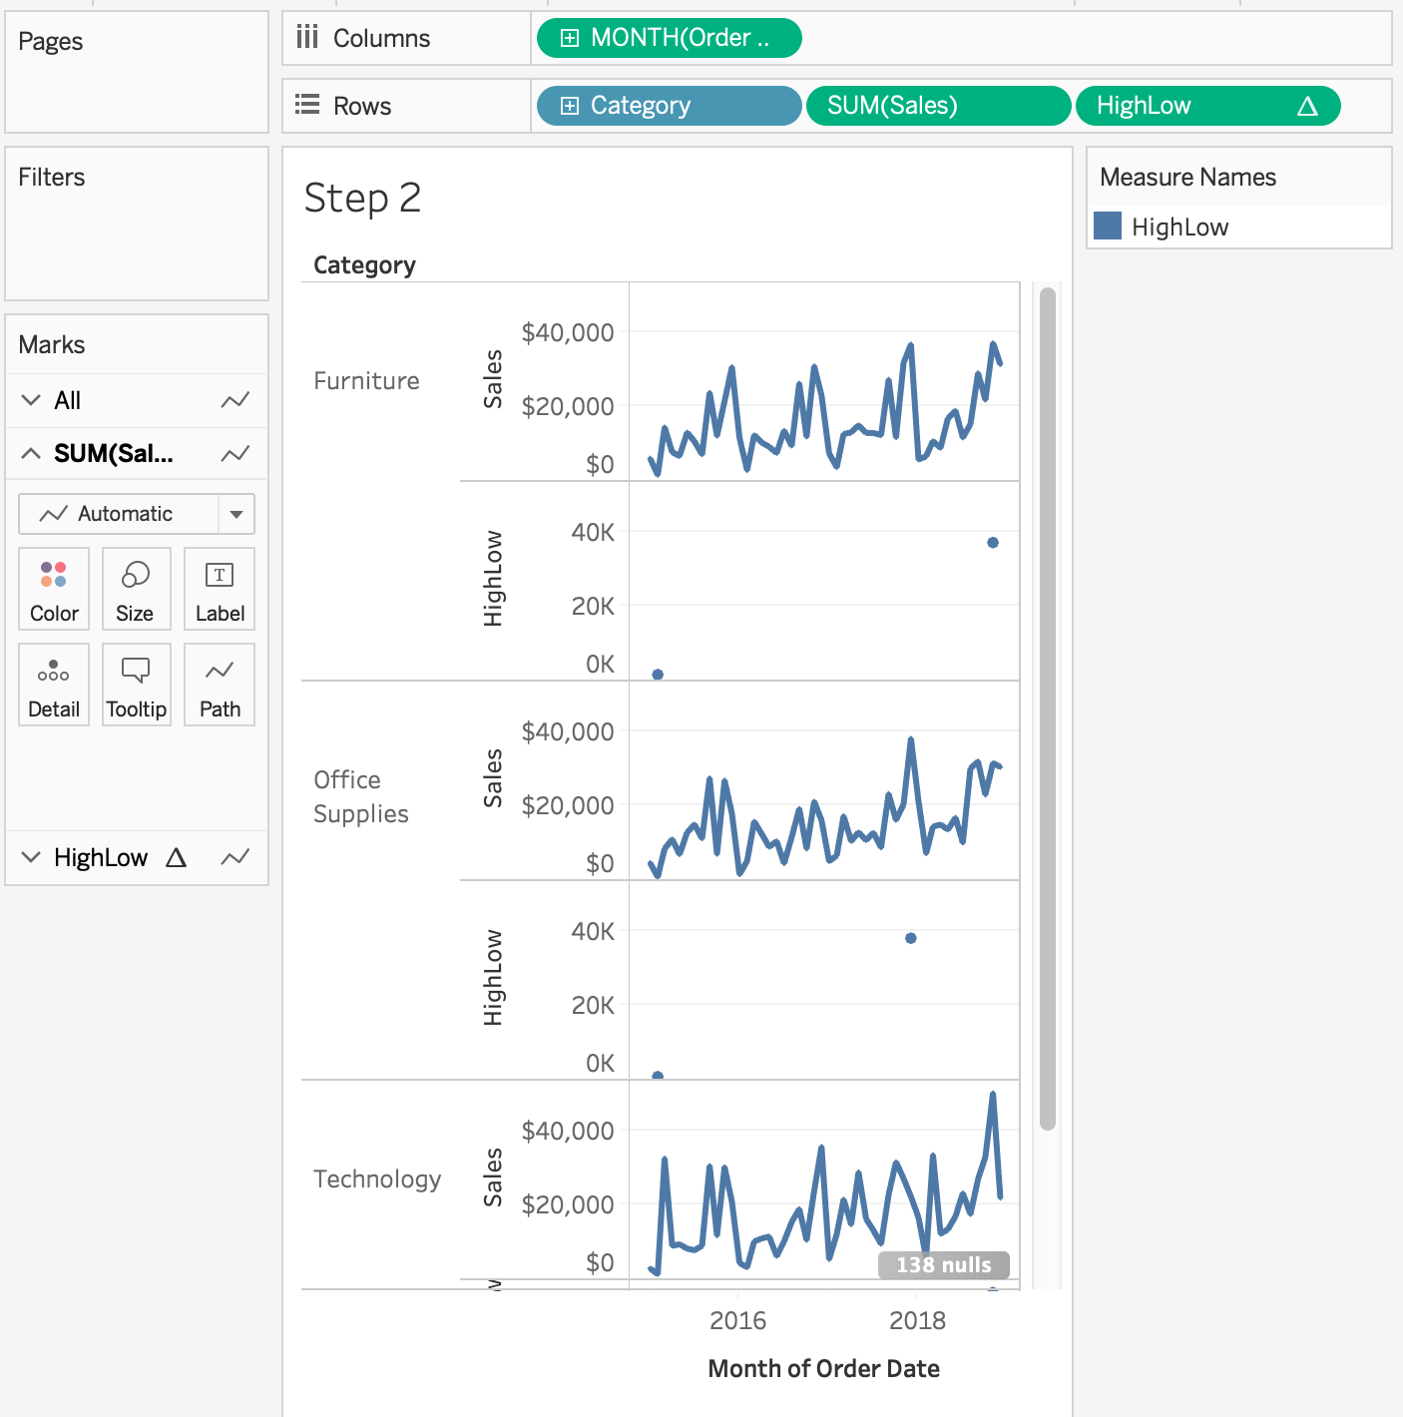
Hands On - Sparklines
Add HighLow to the Rows Shelf.
Your graph should look like this:

Slide 12
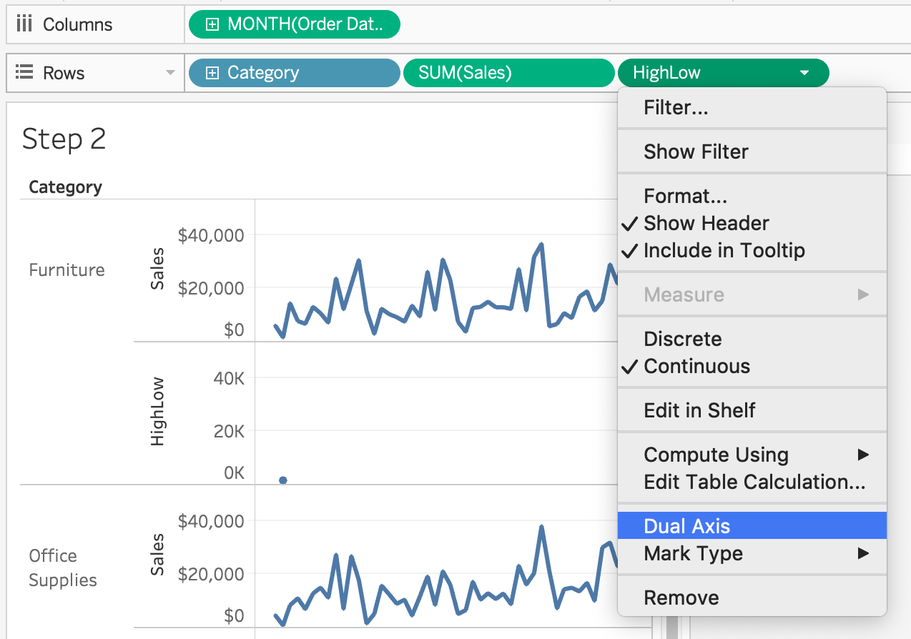
Hands On - Sparklines
Now right-click HighLow and choose dual axis.

Slide 13
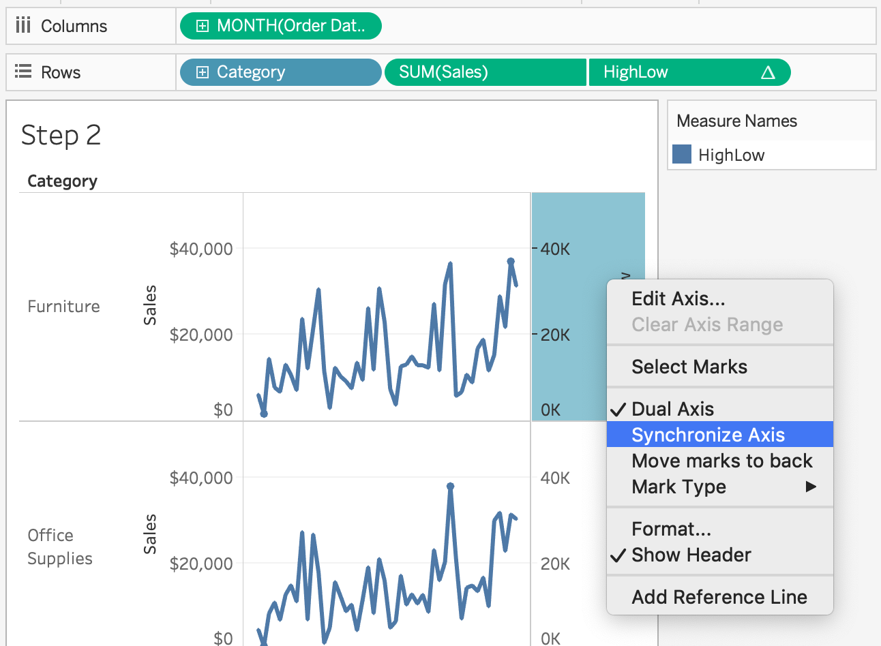
Hands On - Sparklines
Now synchronize the axes.

Slide 14
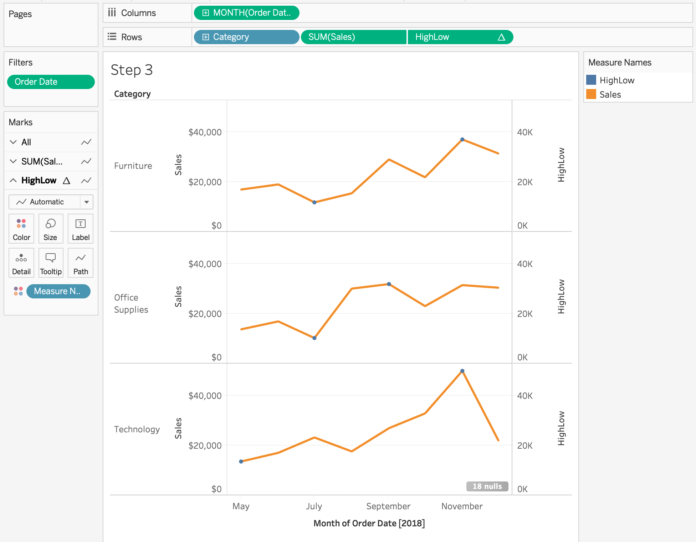
Hands On - Sparklines
Your graph should look like this:

Slide 15
Adding The High/Low Color
Your workbook has a field called “Color”. Right click and open it for editing to look at the formula:

Slide 16
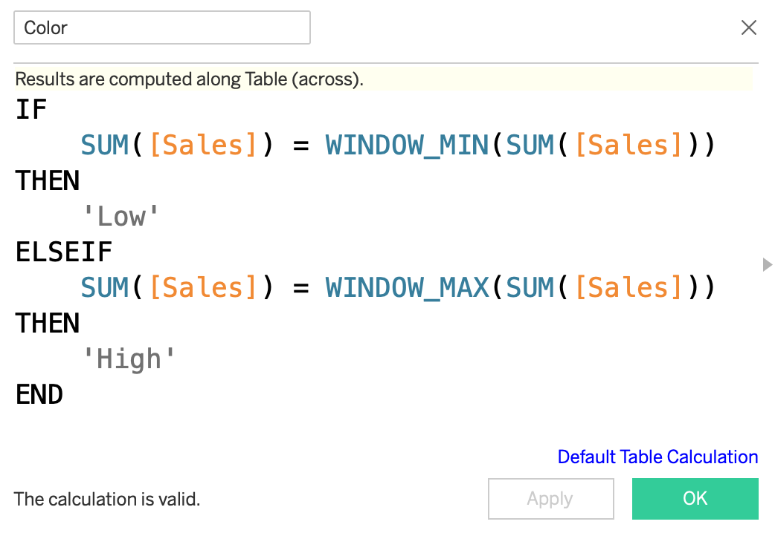

Slide 17
Adding The High/Low Color
Add the Color field to the Color mark on the HighLow Marks Card
Your graph should look like this:

Slide 18
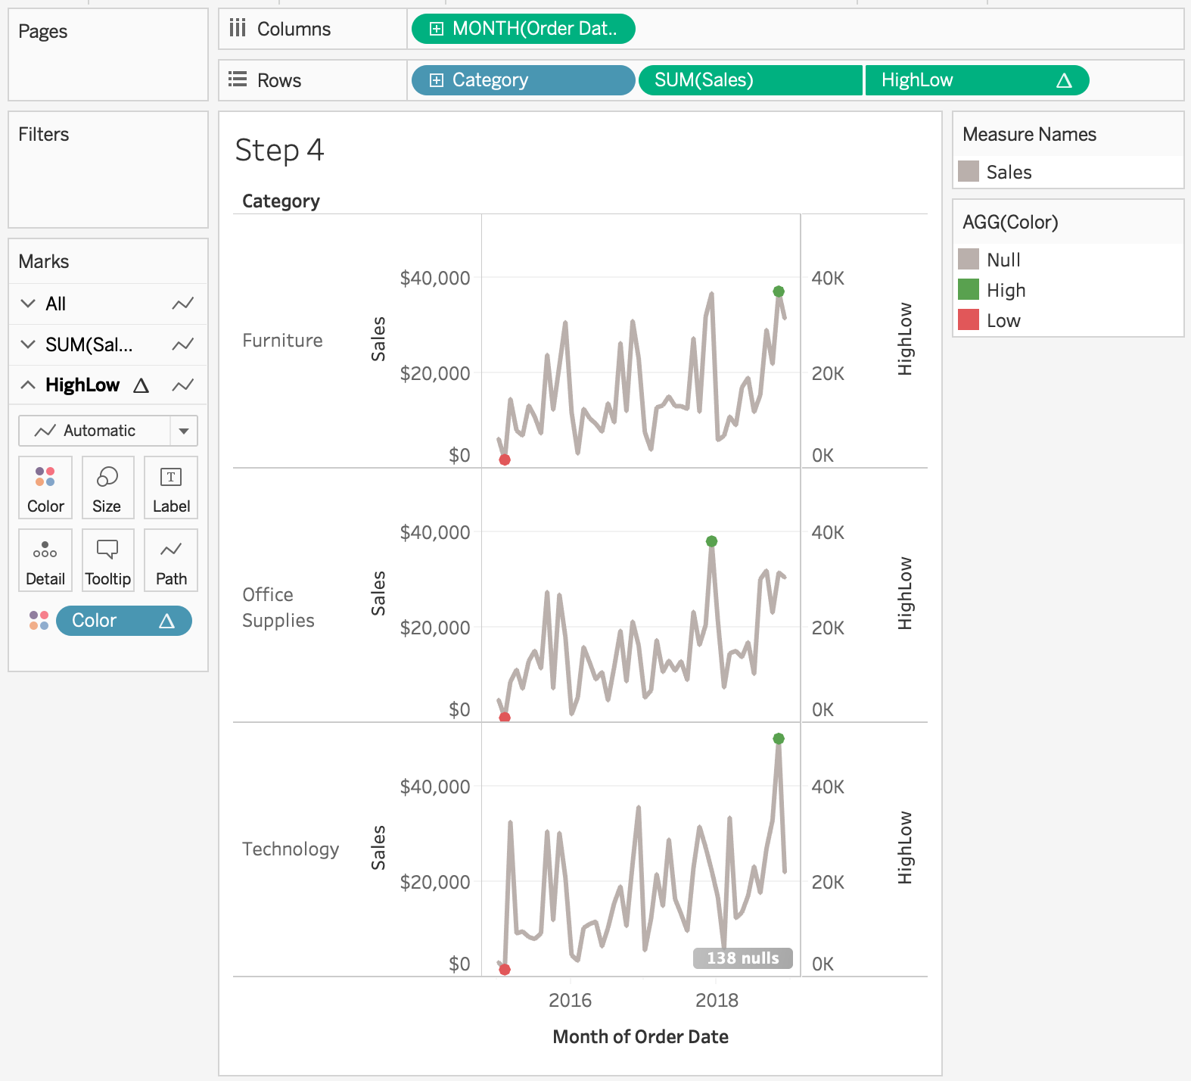
Adding The High/Low Color

Slide 19
Finishing the Sparklines
Change the color of the sales line to light gray.
Change the color of the High/Low to red and green.
Hide the Measure Names and AGG(Color) Cards.
Hide the Sales/HighLow Header.
Hide the Month(Order Date) Header.
Resize the graph to make the sparklines compact.
Remove all grid lines (format menu).

Slide 20
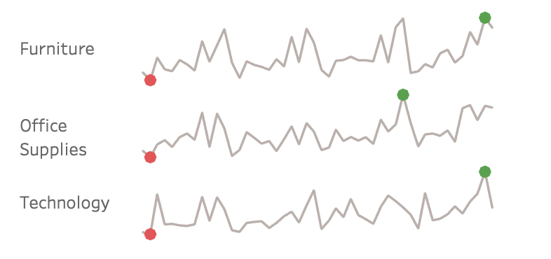
Finishing the Sparklines

